Slide 1
Comparative Response of Littleneck and Manila Clams From The Puget Sound to Ocean Acidification Conditions Year 1
PCSGA 2022
Larken Root
CICOES postdoctoral researcher
Roberts Lab, UW School of Aquatic and Fisheries Science
Co-authors: Mackenzie Gavery, NOAA Ryan Crim, Puget Sound Restoration Fund

Slide 2
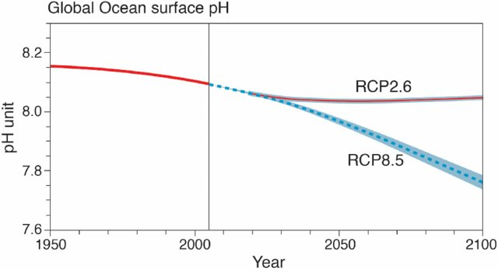
Ocean acidification (OA)
Increasing carbon dioxide in the atmosphere leads to increased concentration in oceans due to diffusion.
Increased pCO₂ leads to lowering pH through a series of reactions with water
Ocean pH is projected to decrease by up to 0.4 units by 2100
From Maslin, 2019

Slide 3
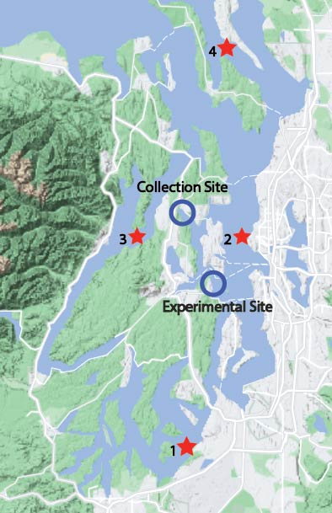
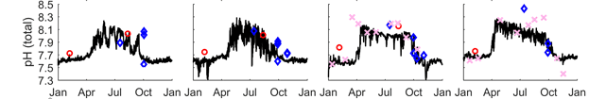
Ocean acidification (OA)
Ocean acidification (OA)
(1) Gordon Point (2) West Point (3) Hood Canal (4) Saratoga Passage
From Bianucci et al. 2018

Slide 4
Impact on Bivalves
Research has identified several potential impacts of OA conditions on shellfish, including:
Biomineralization – the ability of an animal to precipitate and incorporate calcium into the shell
Energetics – changes in energy requirements and the impact on growth
Larval development and growth – impacts on early life stages
Bivalves are most impacted in larval growth

Slide 5
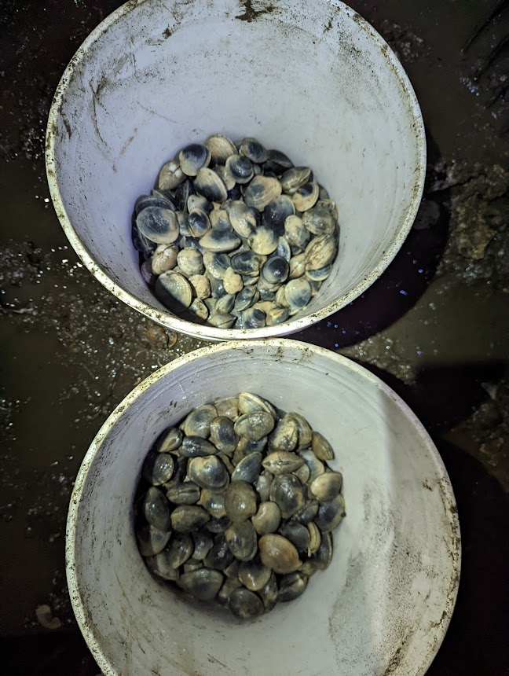
Impact on Aquaculture
Evidence indicates that native Pacific coast bivalves may be more tolerant to low pH as it is a naturally occurring condition.
Are non-native Manila clams more susceptible to OA than native Littleneck clams?
Clams collected in Liberty Bay

Slide 6
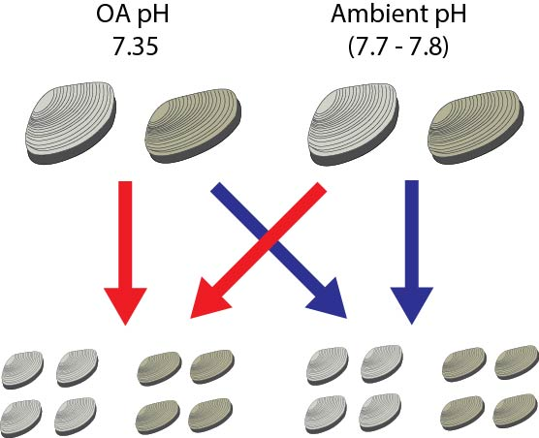
Research questions
Adults
Are native clams more tolerant of OA conditions, as seen in other bivalve species native to the Puget Sound?
Larvae
Can exposure of adults to OA conditions “prime” subsequent larvae to be more tolerant?
Can alternative species or husbandry practices improve resiliency to OA?

Slide 7
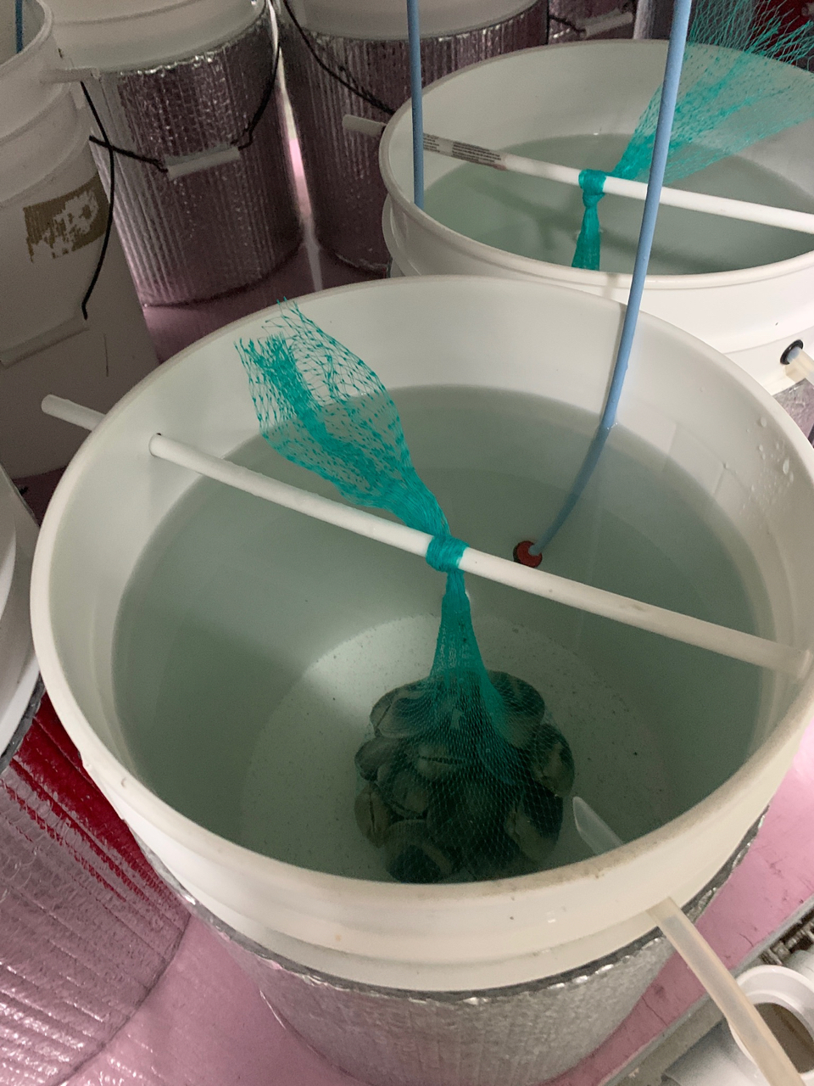
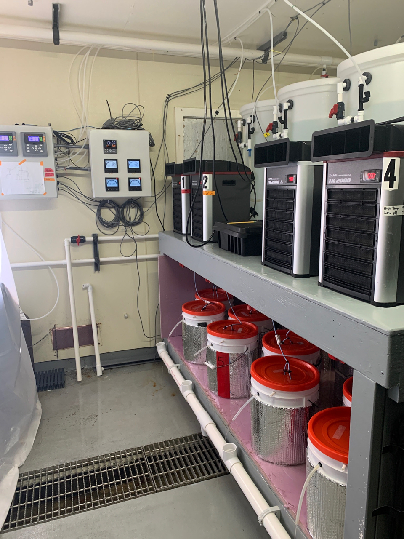
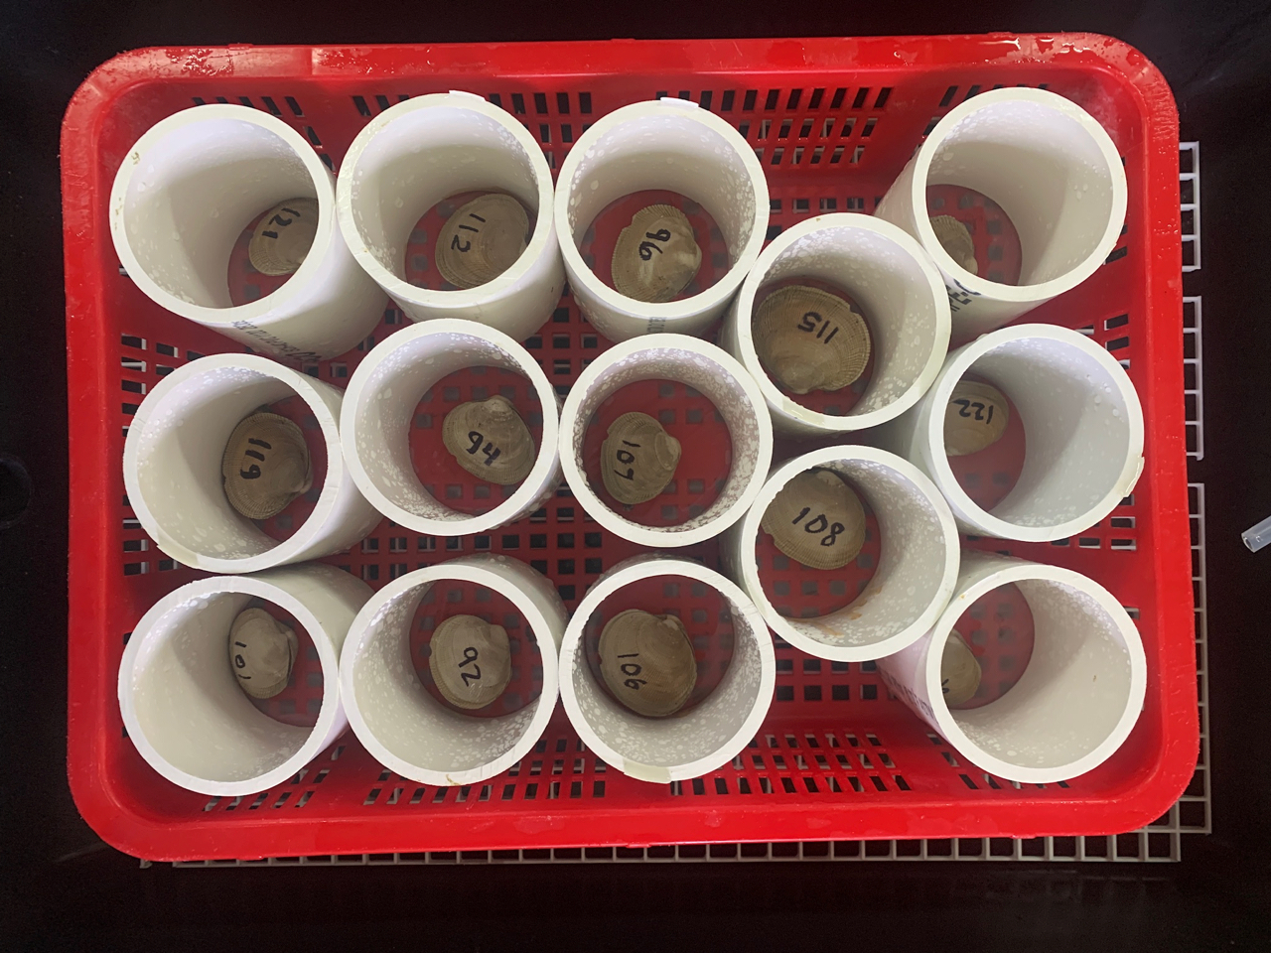
Experimental set-up
4 weeks preacclimation to common conditions
2 weeks at OA condition
2 weeks temperature increase
2 weeks at final temp and pH
First spawning
Respirometry testing
2 weeks Larval Rearing
Second spawning
Final sample collection

Slide 8
Sampling
Adults
Survival
Spawning success
Final reproductive stage
Oxygen respiration
ATPase activity
Gill gene expression
Gamete gene expression and small RNA profile
Larvae
Survival
Growth
Gene expression
Stage
Data analysis
Data collection
Sample prep
Redo in Year 2

Slide 9
Results - overview
Survival was high in all groups, indicating that adults from both species of clams are capable of living for extended times at low pH.
Spawning success was low, likely due either to insufficient maturation or issues with the methodology. Further analysis of histological sections can help clear this up
Complications with spawning and larval rearing led to no data collection for larvae
Treatment | Survival | Spawning
Littleneck Ambient | 90.9% | 20%
Littleneck OA | 88.6% | 29.5%
Manila Ambient | 97.7% | 25.6%
Manila OA | 93.2% | 11.6%

Slide 10
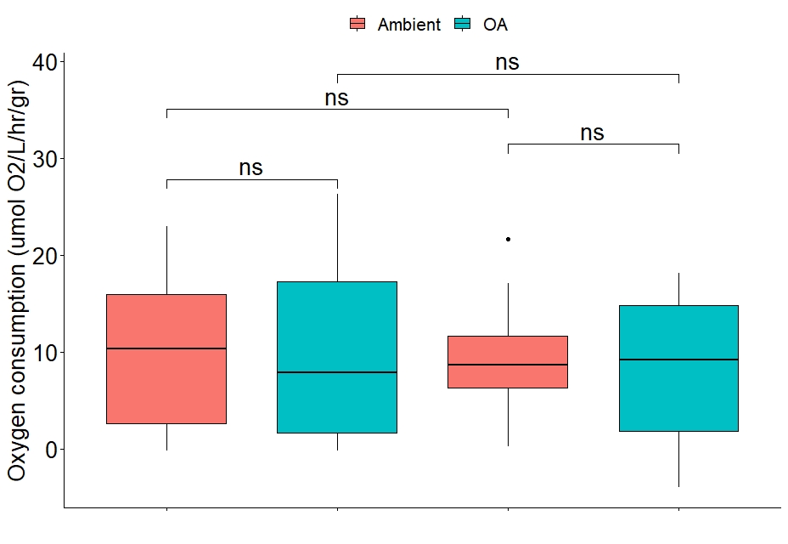
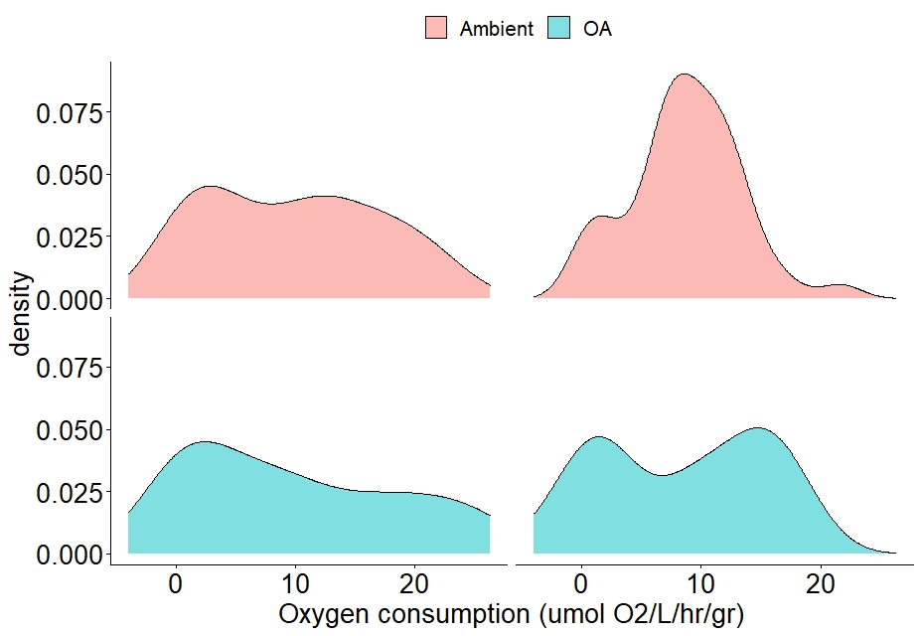
Respirometry
Measurements of oxygen consumption by individual clams over approximately one hour
No difference was seen between treatments or species, but data distributions show more “closed” behavior in littlenecks and treatment groups
Littleneck
Manila
Littleneck
Manila

Slide 11
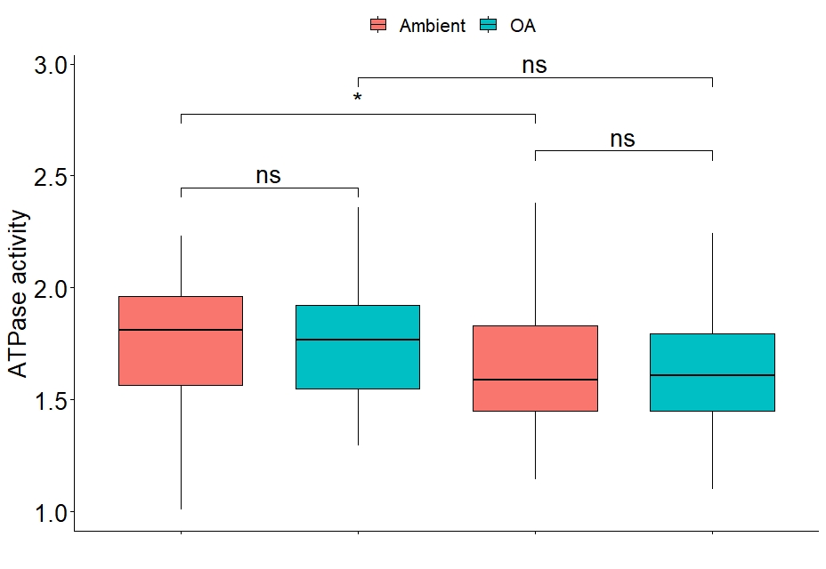
Na⁺/K⁺ ATPase activity
ATPase activity is an indicator of ionic balance and metabolic activity.
Littleneck clams at ambient pH had significantly higher activity than Manila clams, but there was no difference within either species due to low pH.
*
Littleneck
Manila

Slide 12
Early conclusions and next steps
So far, there is no evidence that either species is more tolerant of low pH, or that either is very sensitive as adults.
Further investigation of gene expression may reveal differential responses, as well as comparing response based on reproductive maturation.
Future experiments with improved spawning and larval rearing will help us understand sensitivity in larvae to OA, and the potential of parental priming in improving outcomes.

Slide 13
Survey
The goal of this project is helping growers, and we need to make sure the research is making an impact
We plan to set up grower interviews before and during PCSGA 2023
For growers, we want to know;
What experiences do you have with OA?
Given upcoming results, what practices might you be open to adopting to prepare for OA in the future?

Slide 14
Acknowledgements
We received invaluable support and guidance from:
Elizabeth Unsell, Suquamish Tribe
Alexa Romersa, Pacific Hybreed
Matt George, CICOES Post-doc
Delaney Lawson, UW SAFS
Eileen Bates, UW SAFS
Mollie Middleton, NOAA
Questions?

